Slide 1
Research Based Instructional Strategies for English Learners (ELs)
EL Summit 2016
Property of Sara Marr, Martha Soto & Bridgeport Bilingual Department

Slide 2
Objectives
To provide general education teachers with research based instructional strategies that will make their lessons appropriate for English Learners
To create a platform for an open professional learning community of educators committed to meeting the unique needs of learners
Property of Sara Marr, Martha Soto & Bridgeport Bilingual Department

Slide 3
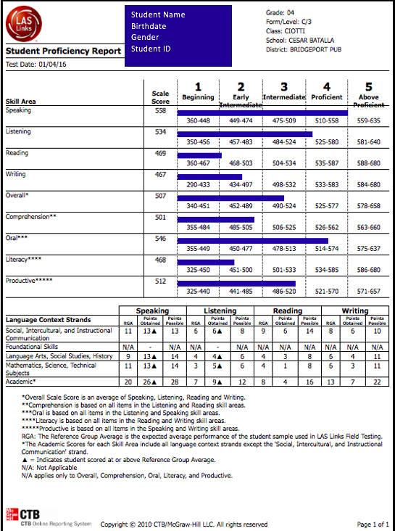
What level are
my ELs?
Noteworthy Information
Oral Skills (Speaking & Listening) significantly more developed
  Level 4
Literacy Skills (Reading & Writing) less developed
  Level 2
Sample LAS Links
Grade 4 Report
Property of Sara Marr, Martha Soto & Bridgeport Bilingual Department
Notes:
Conversational language is proficient while academic language is still developing.

Slide 4
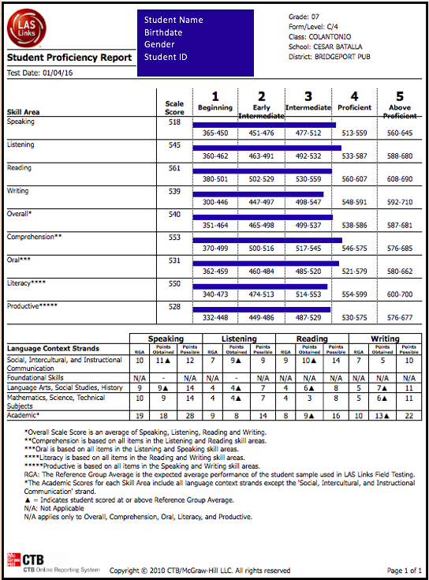
What level are
my ELs?
Noteworthy Information
Oral Skills (Speaking & Listening) more developed
  Level 4
Literacy Skills (Reading & Writing) less developed
  Level 3 & 4
Sample LAS Links
Grade 7 Report
Property of Sara Marr, Martha Soto & Bridgeport Bilingual Department
Notes:
This student’s conversational and academic language are both well developed.

Slide 5
How can I help my ELs be successful based on their levels?
RESC Alliance ELL Strategy Desk Cards - included in your gift bags
Property of Sara Marr, Martha Soto & Bridgeport Bilingual Department

Slide 6
Visuals
"A picture is worth a thousand words." - Unknown
Using visuals with English Learners (ELs) in your classes is very beneficial not only for them but for your other students as well. Utilizing visuals can give them background knowledge and help them better understand concepts in English.
Some examples are:
pictures for key vocabulary terms
realia
pictures of everyday needs: bathroom/nurse/water fountain (alleviate their anxiety)
videos
Property of Sara Marr, Martha Soto & Bridgeport Bilingual Department
Notes:
Realia stimulates the

Slide 7
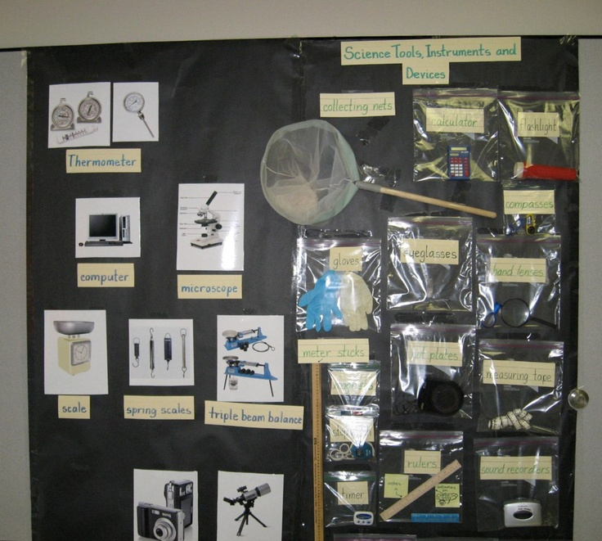
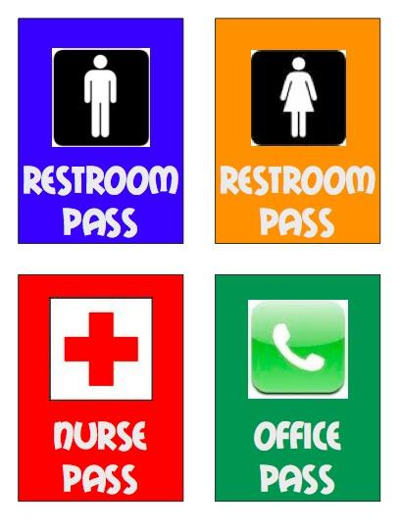
Visuals cont.
Property of Sara Marr, Martha Soto & Bridgeport Bilingual Department
Notes:
Passes can be put on newcomers’ desks, that way they can communicate with you without speaking.
Realia for science materials.

Slide 8
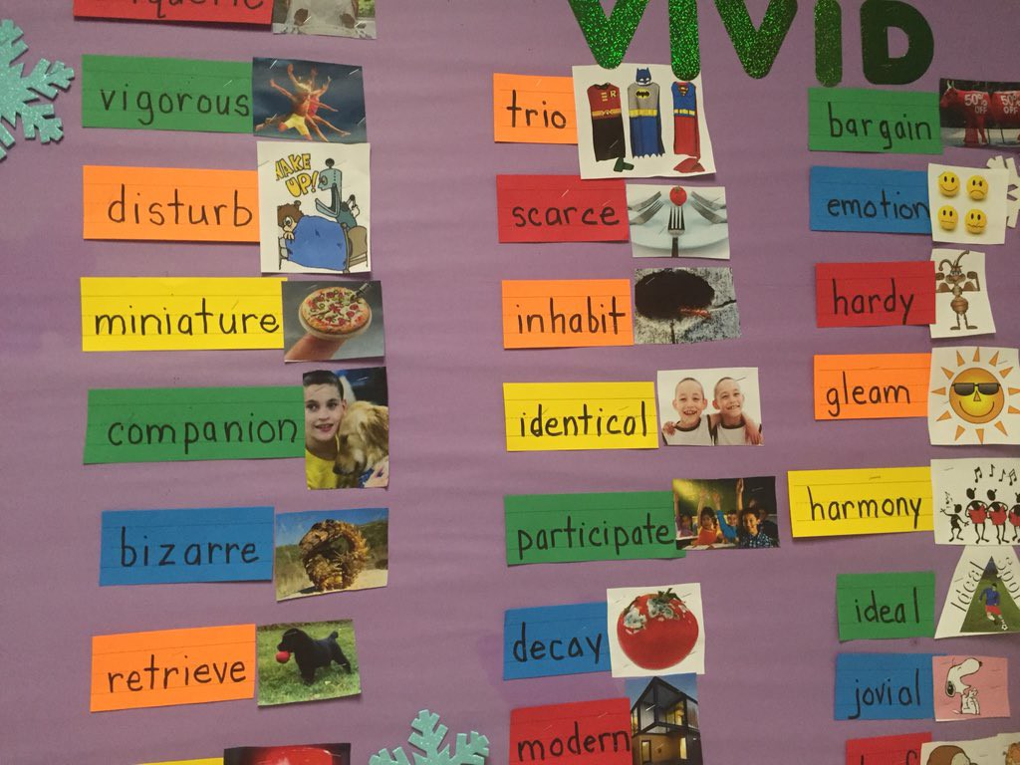
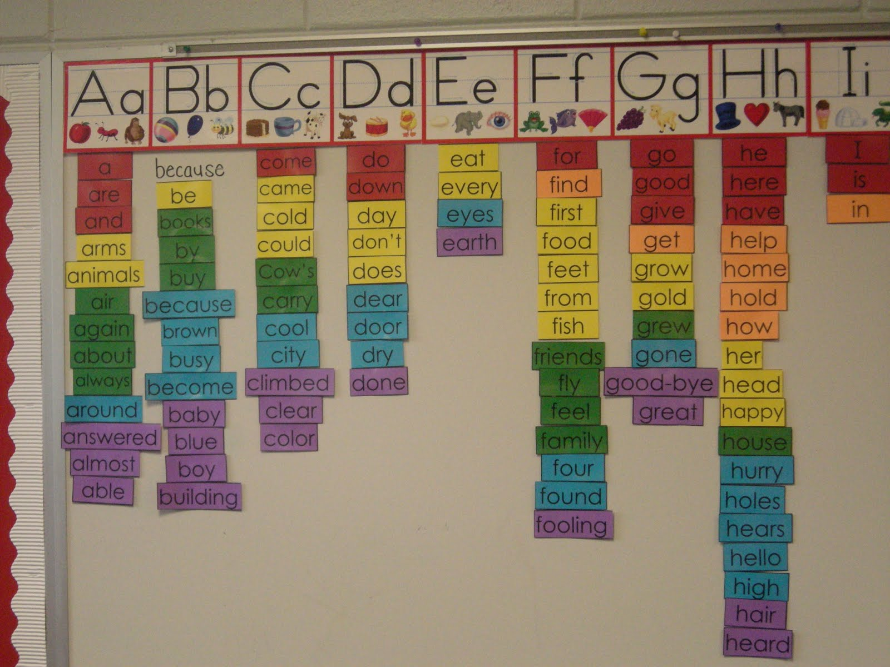
Word Walls
Property of Sara Marr, Martha Soto & Bridgeport Bilingual Department

Slide 9
Personal Dictionaries
New Arrivals - write the word in English, draw a picture, and write the word in their native language
This activity can be modified for all different language proficiency levels
  Instead of drawing a picture, have students…
    Use the word in a sentence
    Write a synonym or antonym
    Write their own definition of the word
    Write examples and nonexamples of the word
Word in English | Picture | Word in Native Language
Property of Sara Marr, Martha Soto & Bridgeport Bilingual Department

Slide 10
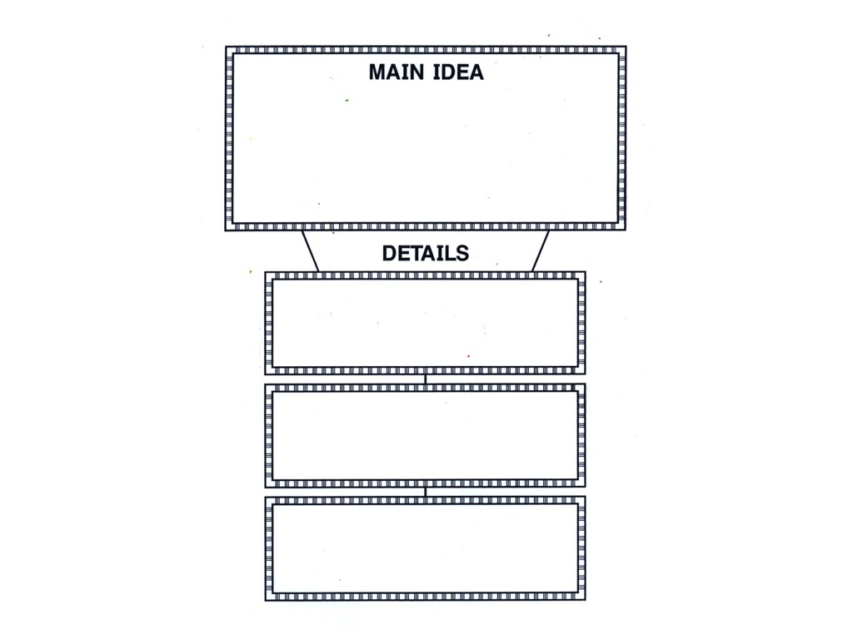
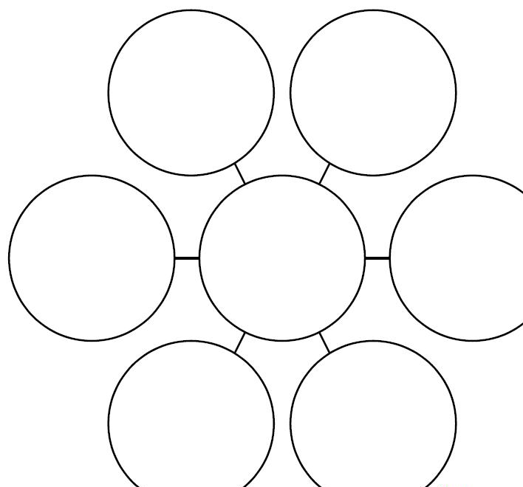
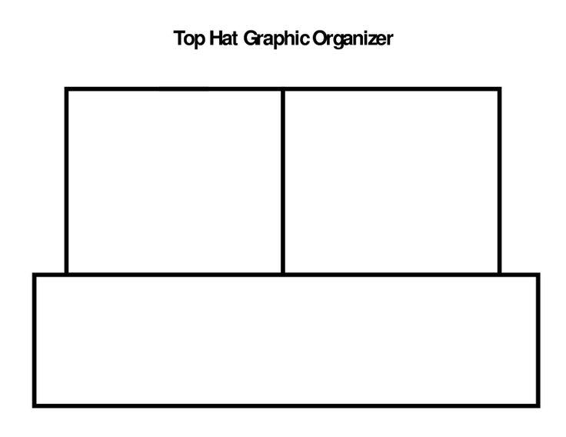
Graphic Organizers
Graphic organizers help students to visualize the connections between ideas, information, and concepts.
Property of Sara Marr, Martha Soto & Bridgeport Bilingual Department

Slide 11
Sentence Frames and Starters in Speaking and Writing
Sentence frames provide an opportunity for students to use key vocabulary in a sentence structure that may be higher than what they can produce on their own
  Developing sentence frames
    Think of ways to respond to prompts and remove the key vocabulary
      How did the main character change throughout the story?
      In the beginning the main character __________________, but by the end ____________________.
Sentence starters help students to start their idea or sentence
  Sentence starters for sequencing events in a story
    The first thing that happened was…
    After that…
    Earlier in the story…
    Immediately following that...
Property of Sara Marr, Martha Soto & Bridgeport Bilingual Department

Slide 12
Florida Center for Reading Research
FCRR: This website has many free, printable “Student Center Activities” organized grade band K-1, 2-3 and 4-5 with teacher guides. Activities are broken down into:
  Phonological Awareness
    rhyme, syllables, onset and rime, etc.
  Phonics
    letter recognition, letter-sound correspondence, word study, etc.
  Fluency
    high frequency words, oral reading, etc.
  Vocabulary
    word structure, word analysis, words in context, etc.
  Comprehension
    main idea, summarizing, story structure, etc.
Property of Sara Marr, Martha Soto & Bridgeport Bilingual Department
Notes:
Discuss how this website can be used as a resource to help ELs reinforce their language skills.

Slide 13
The International Children’s Digital Library
ICDL: This website has over twenty-five hundred books in forty-eight languages that have been digitally scanned so ELs can read them on the computer
To access books from the Home Page
  Left Side under “The Library”
  First-time Visitors
  Read Books
    Advanced Search feature lets you select different languages
This site allows readers to toggle back and forth between multiple languages of the same text in books
  Increase comprehension of reading
  Uses native language as a support
Property of Sara Marr, Martha Soto & Bridgeport Bilingual Department

Slide 14
Special Considerations
Learn your ELs’ names - how do they want you to pronounce their name? Share the correct pronunciation of their name with their peers and other teachers
Offer one on one assistance when possible
Assign a peer partner
Post a daily schedule using visuals
Use an interpreter
Use materials related to your ELs’ cultures
Label classroom objects in English and your EL’s native language
Use cooperative learning
Have high expectations for your ELs as you do with your non-ELs
Property of Sara Marr, Martha Soto & Bridgeport Bilingual Department

Slide 15
Contact Us…
Sara Aquino - skochaquino@bridgeportedu.net
Jessica Baldizon - jbaldizon@bridgeportedu.net
Luz Butler - lbutler@bridgeportedu.net
Dana Denomme - ddenomme@bridgeportedu.net
William King - wking@bridgeportedu.net
Sara Marr - mrsmarresl@gmail.com
Leslie Perez - lperezverdoni@bridgeportedu.net
Martha Soto - msoto@bridgeportedu.net
Property of Sara Marr, Martha Soto & Bridgeport Bilingual Department

